Slide 1


Iteration 5
Team The Best Team

Slide 2
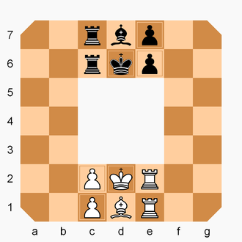
Quick Recap
Rollerball is a variant of chess based off of the 1975 film.
Each player starts with a King, Bishop, two Rooks, and two Pawns
Players move their pieces clockwise to capture the opponent’s king or placing your King in the opponent King’s starting position to win the match.

Slide 3
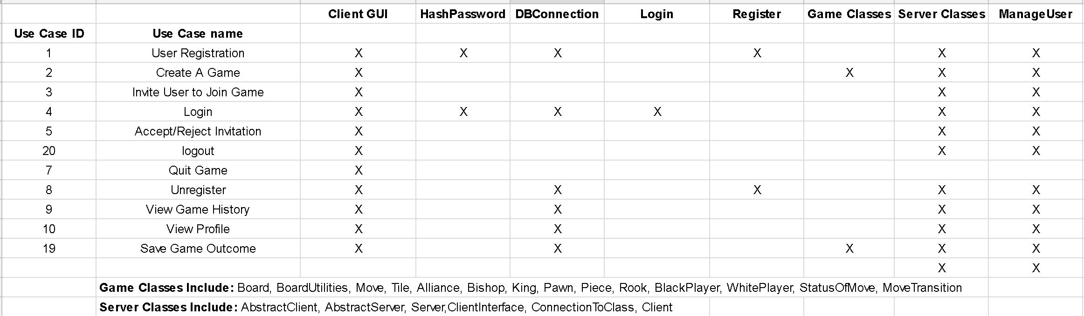
Traceability Matrix

Slide 4
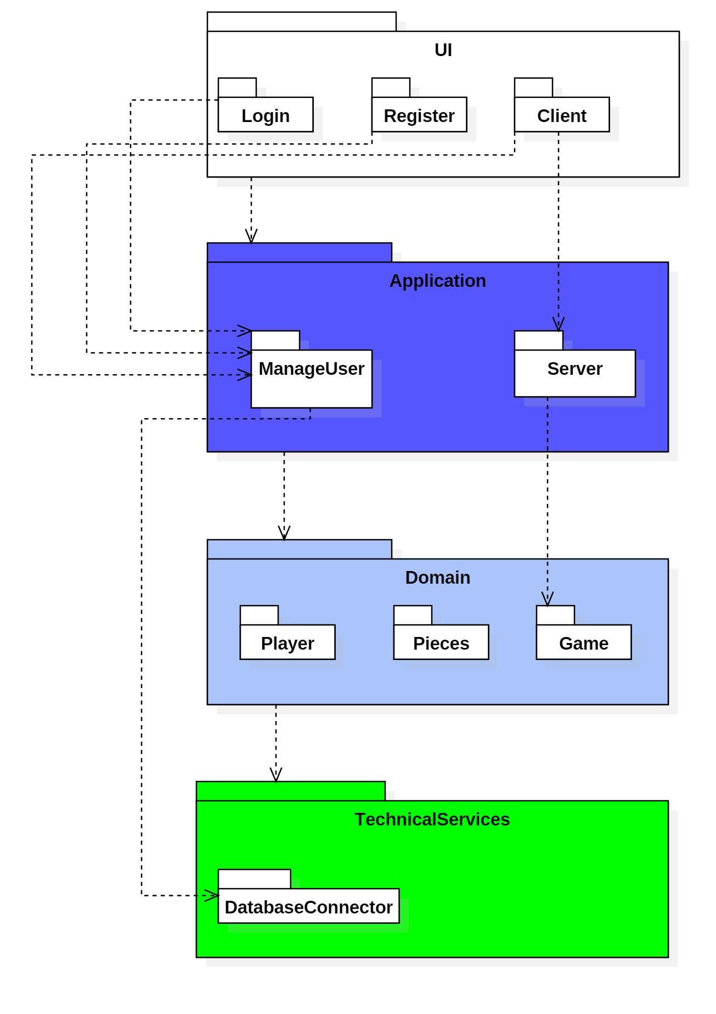
Package Diagram

Slide 5
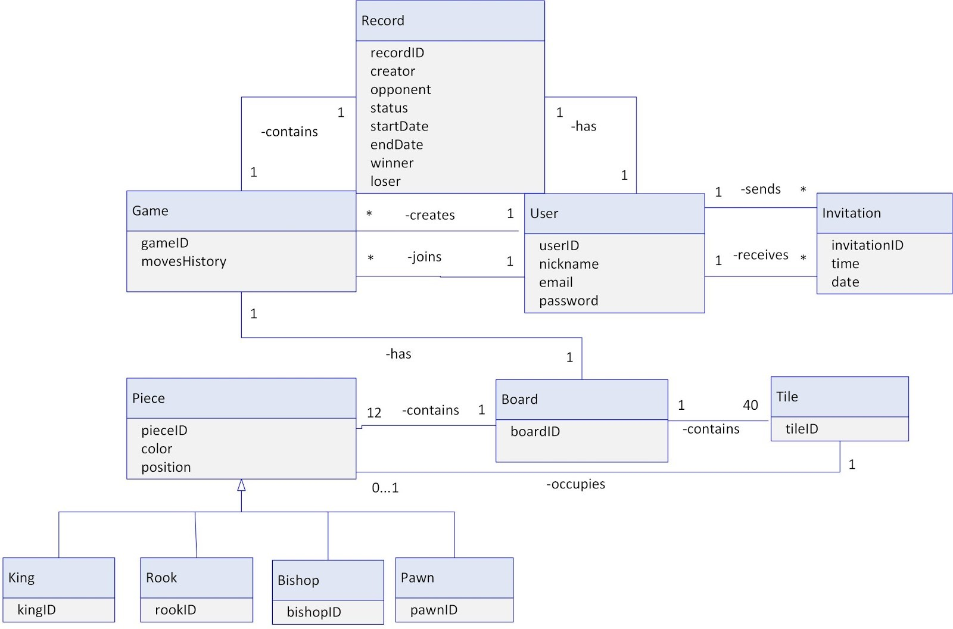
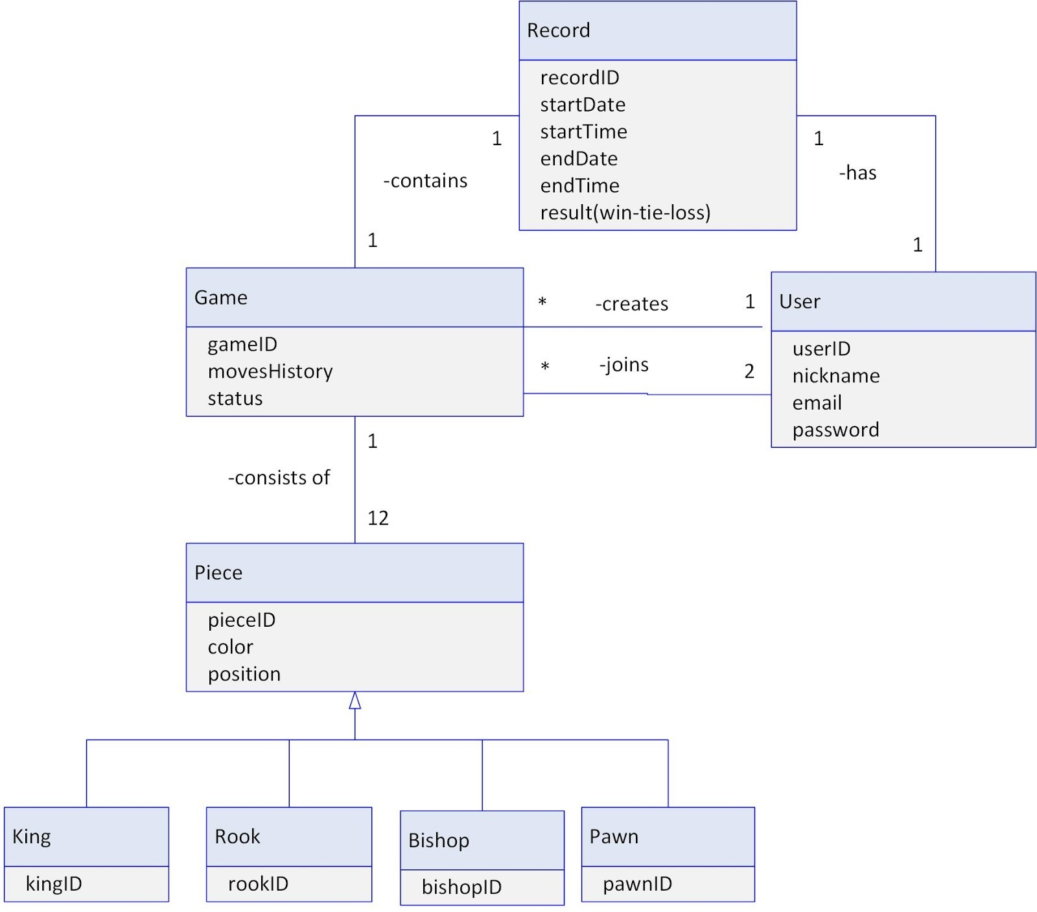
Domain Model
New
Old

Slide 6
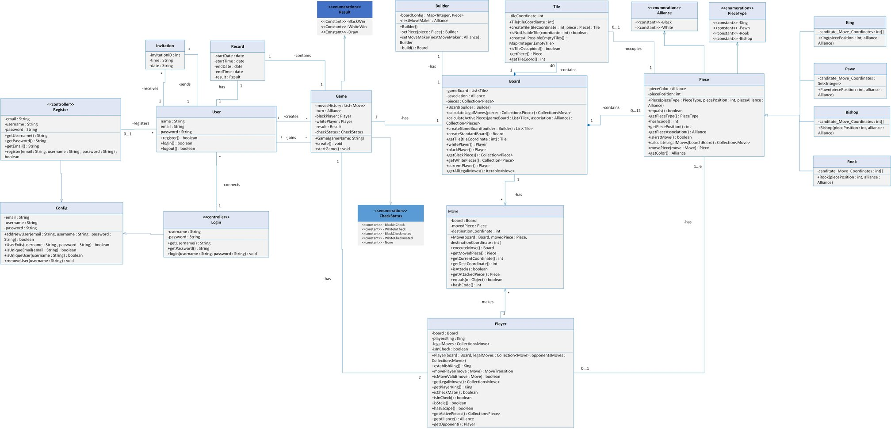
Old Design Class Diagram

Slide 7
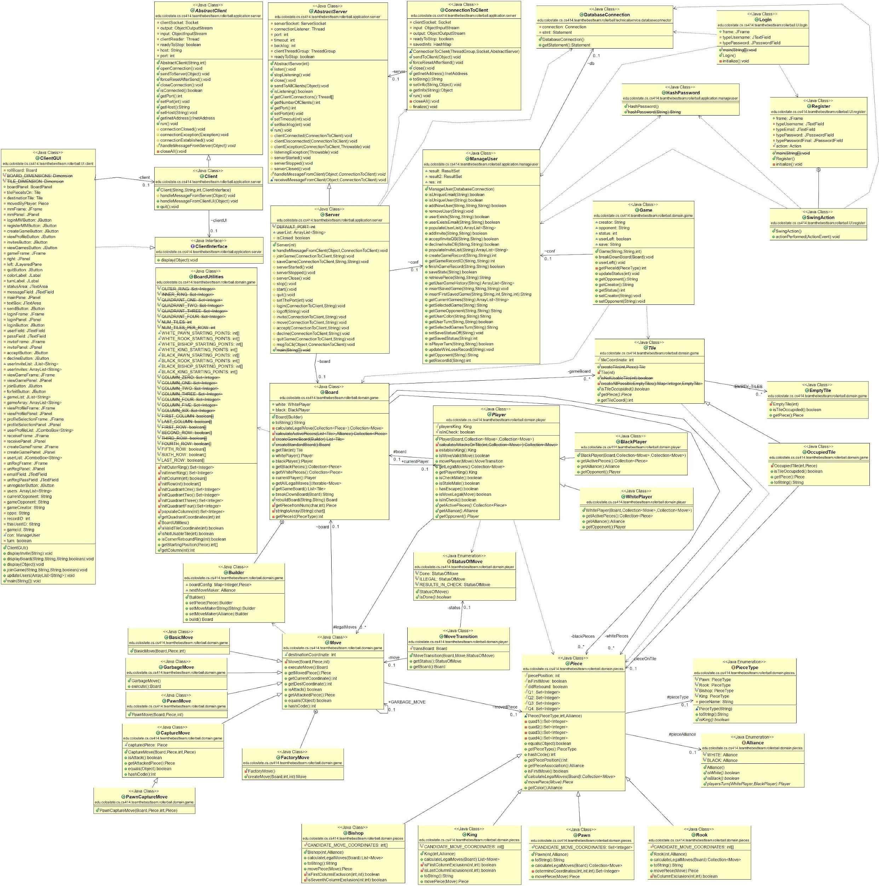
Design Class Diagram

Slide 8
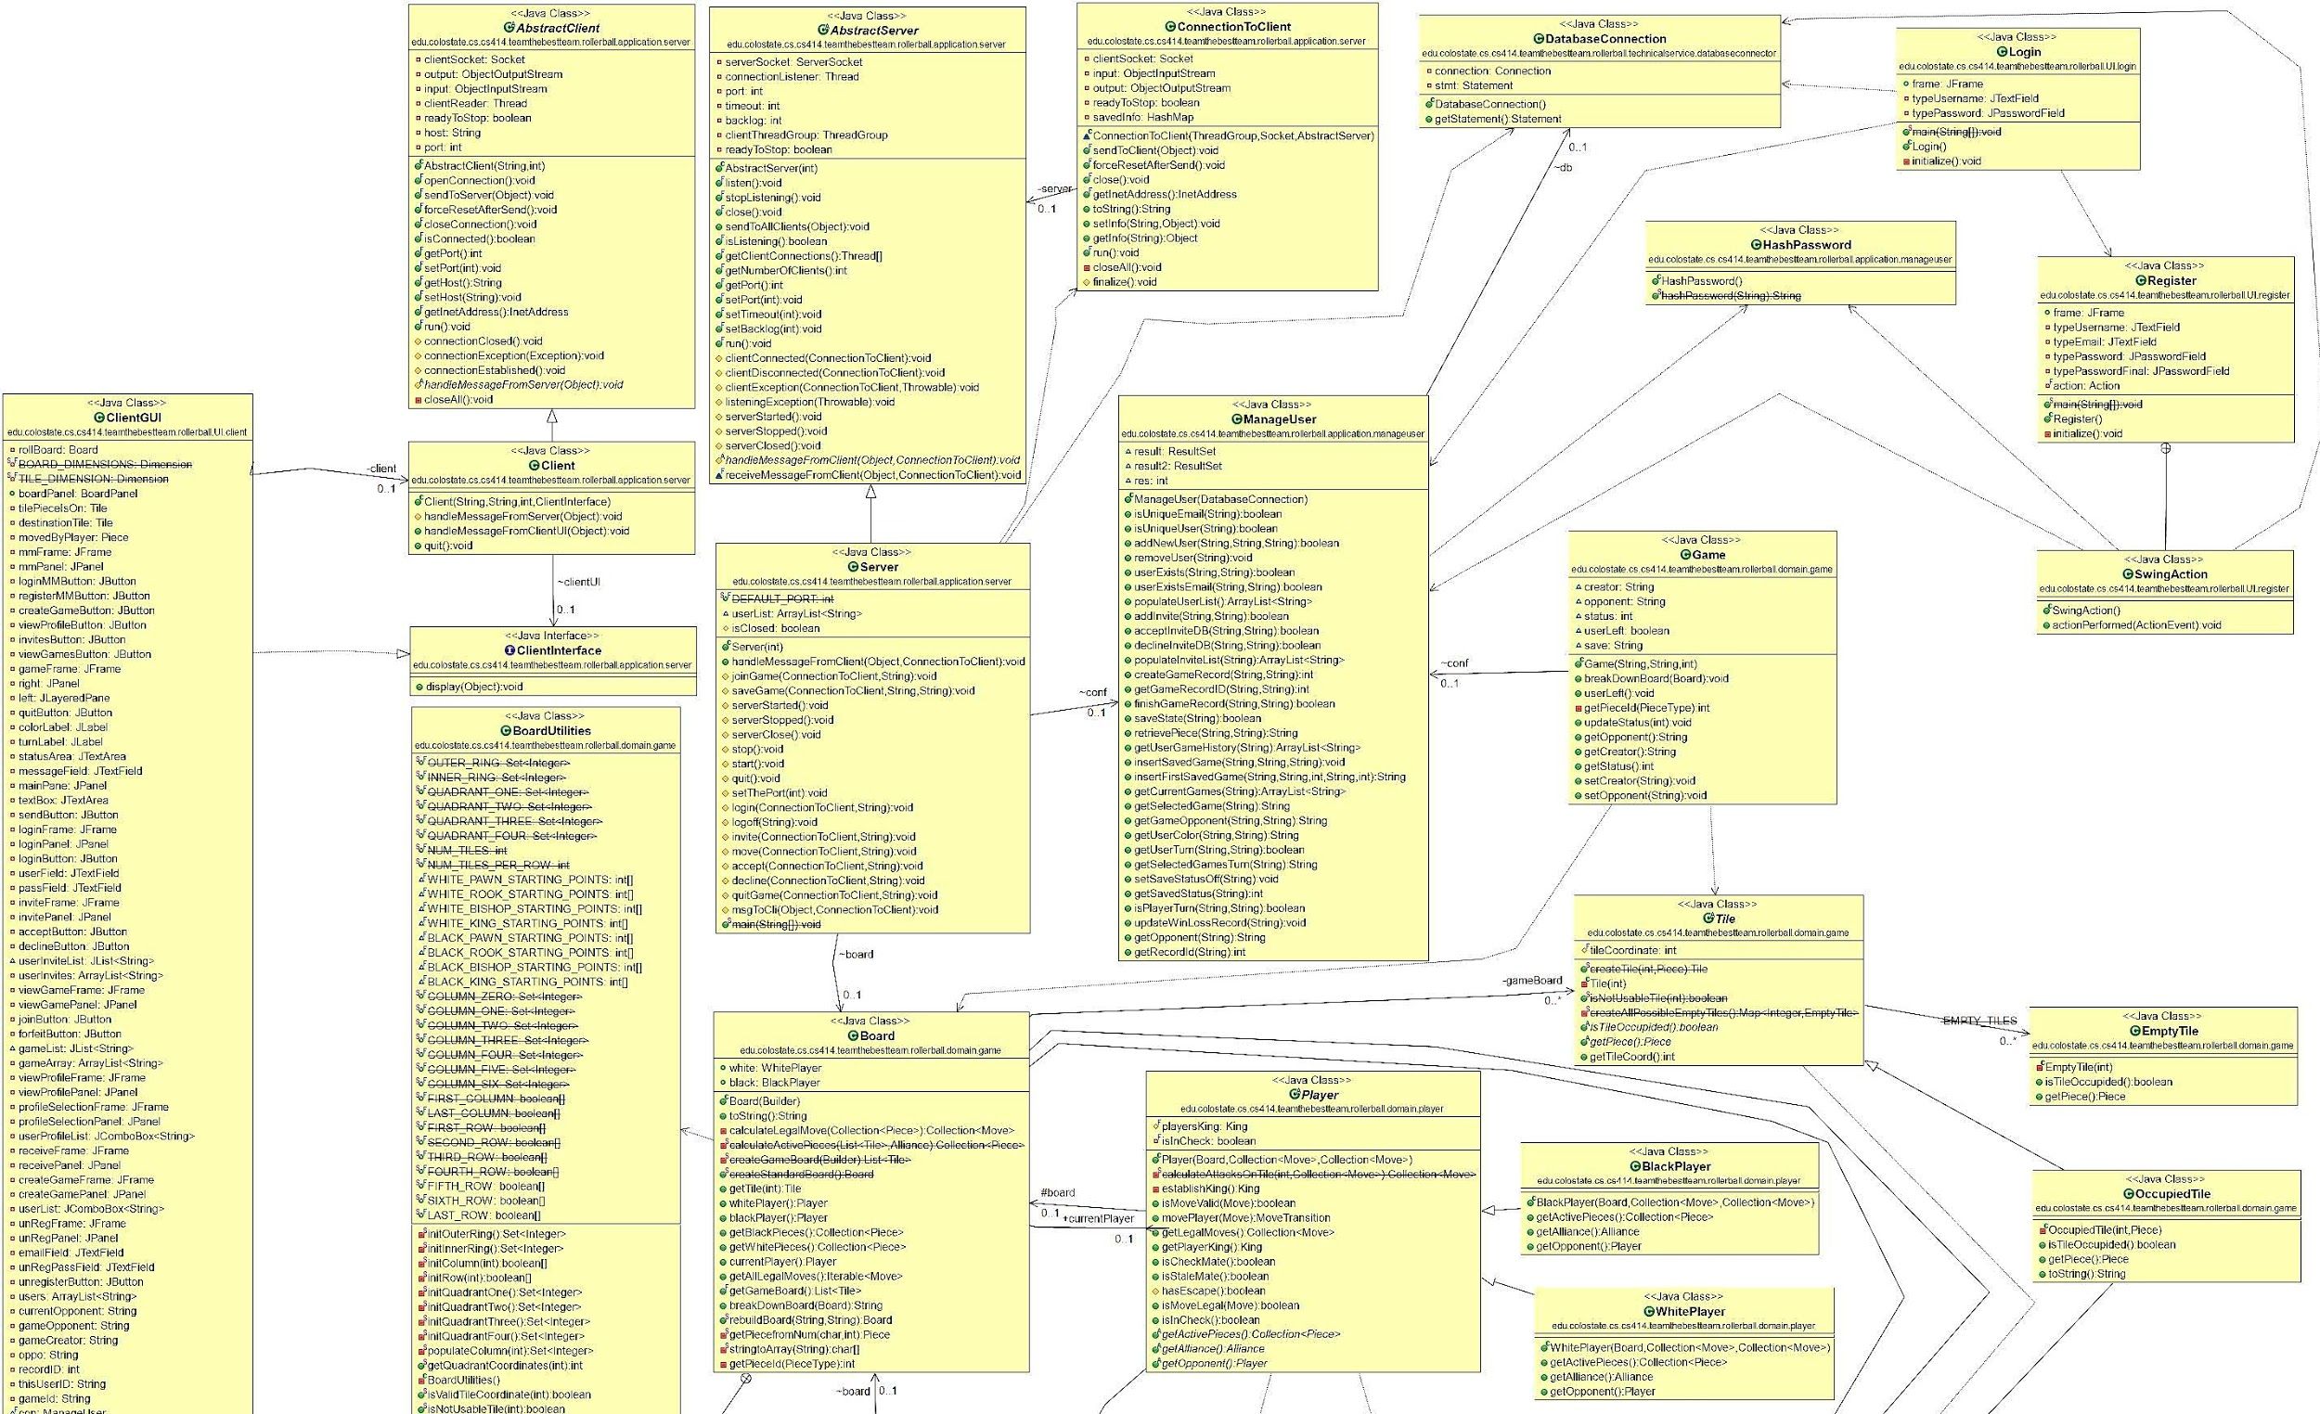
Design Class Diagram

Slide 9
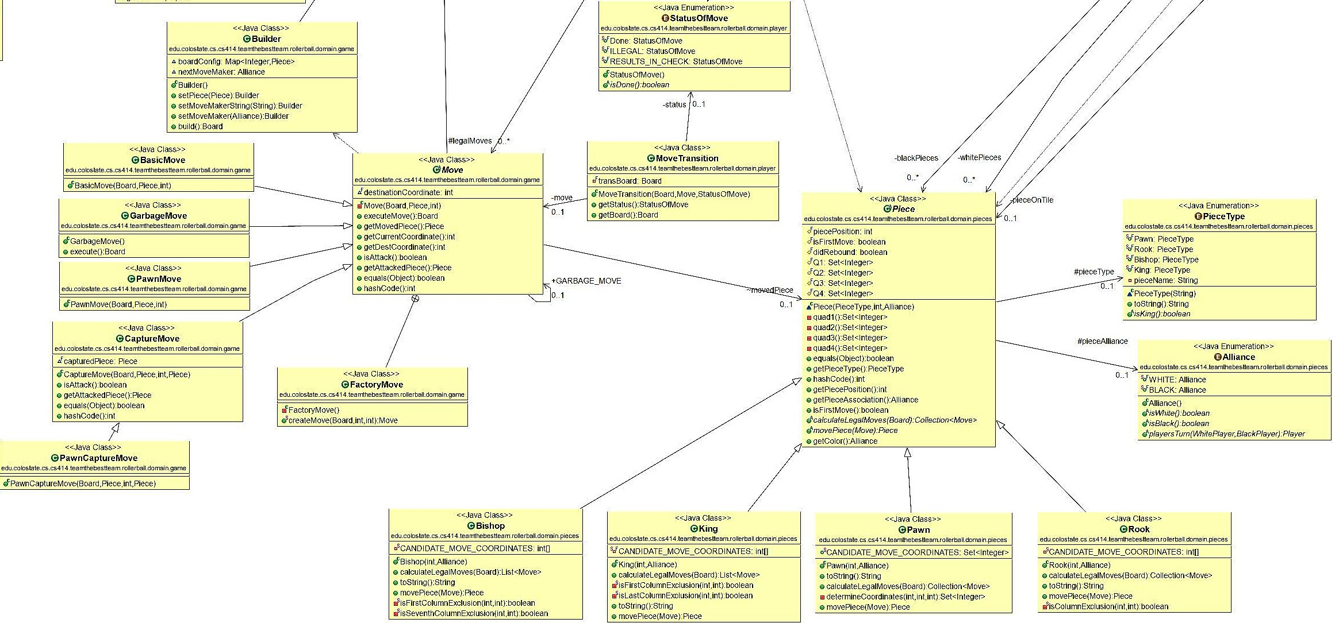
Design Class Diagram

Slide 10
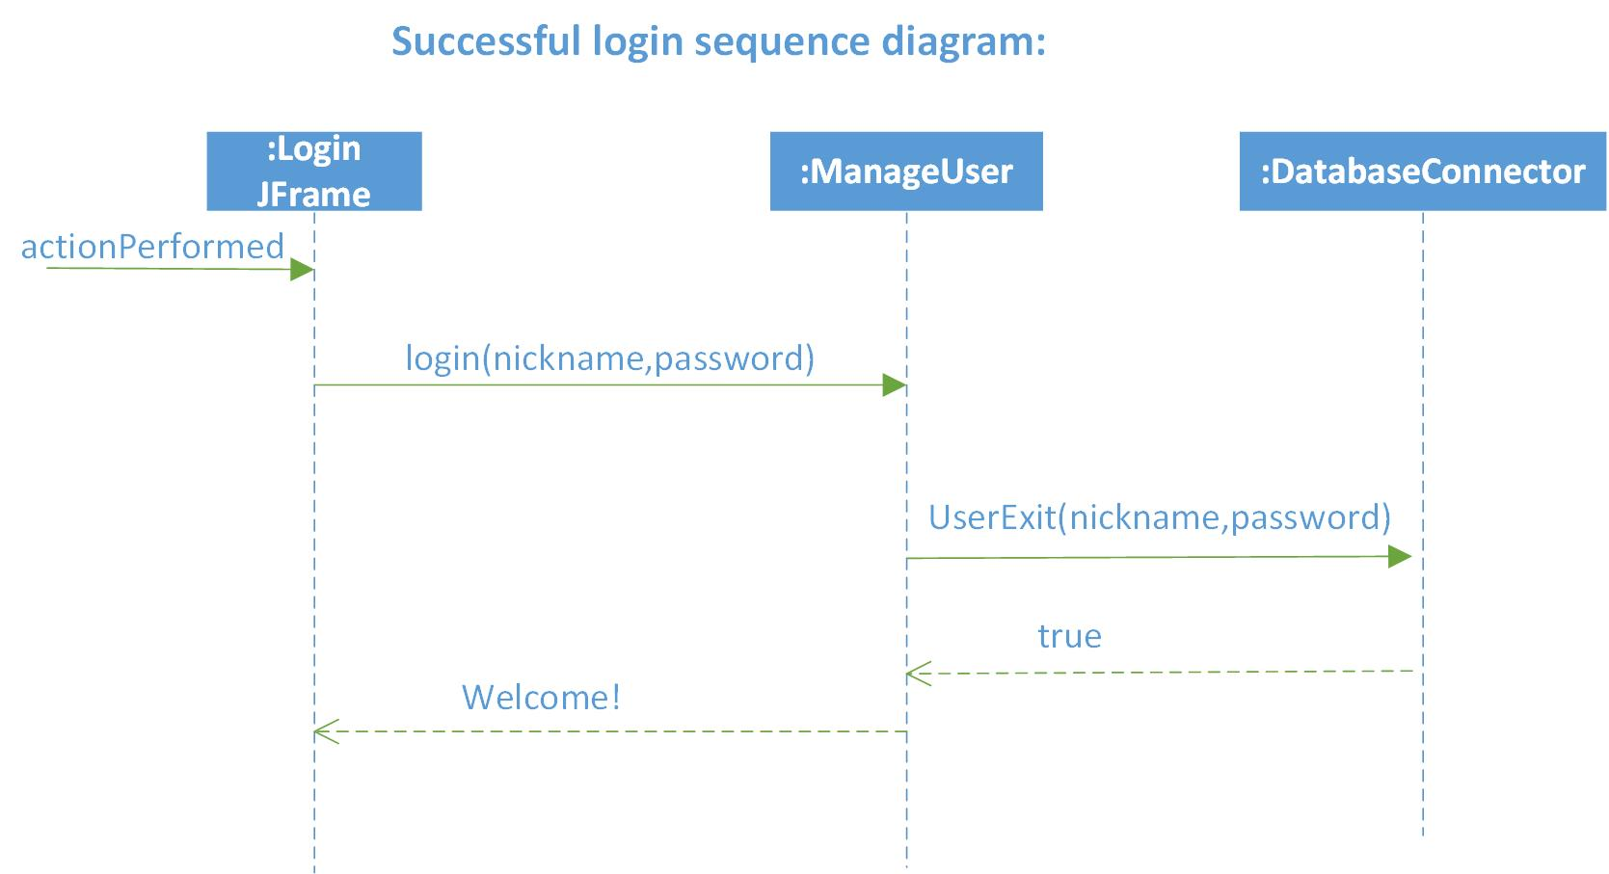
Sequence Diagram

Slide 11
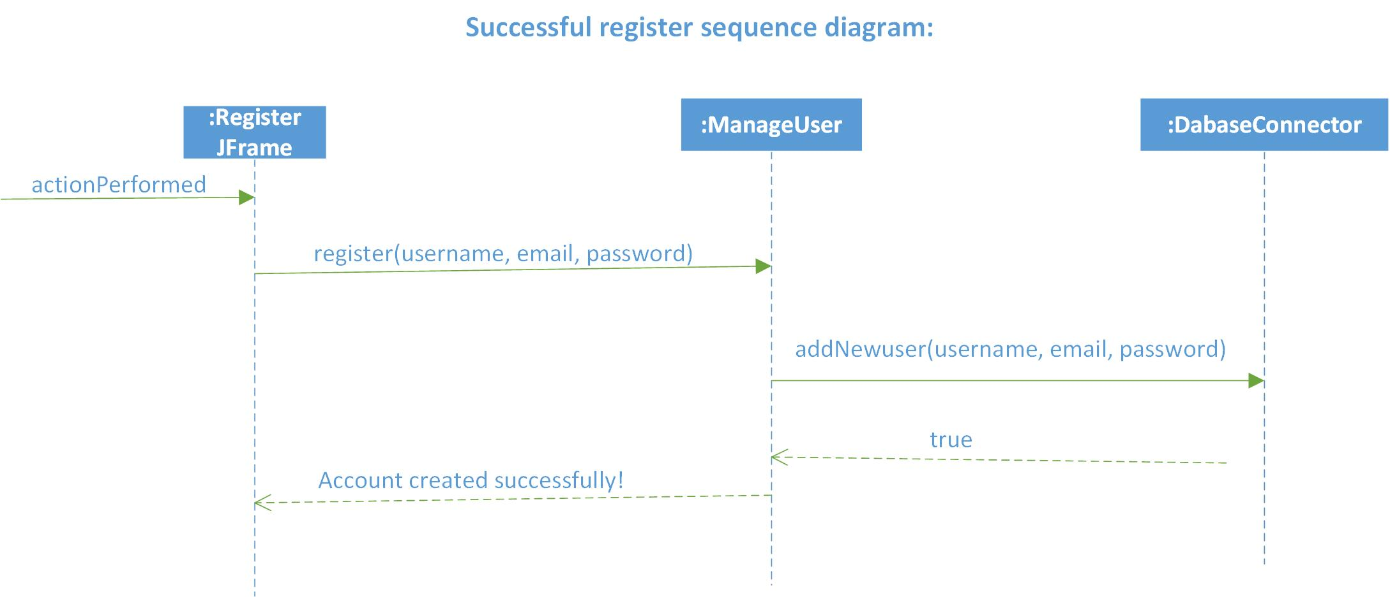
Sequence Diagram

Slide 12
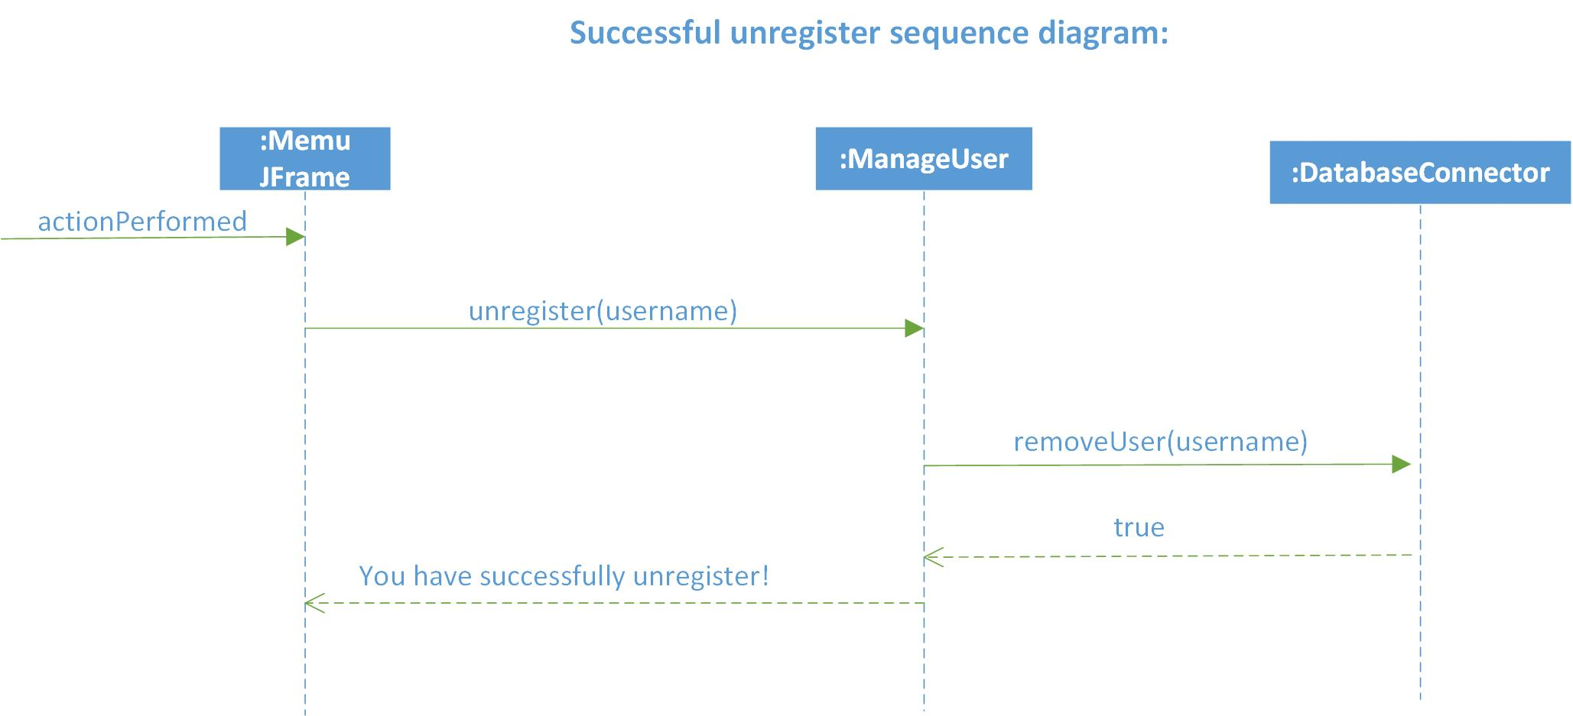
Sequence Diagram

Slide 13
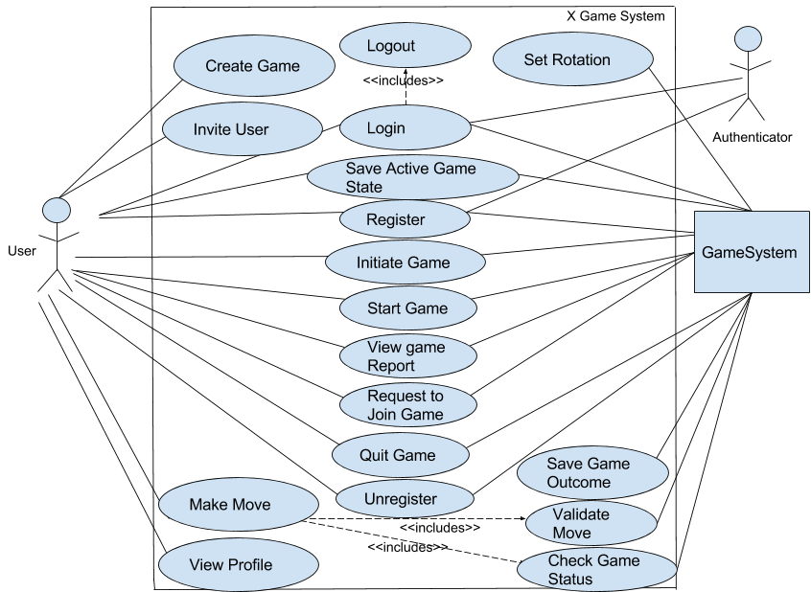
Old Use Case Diagram

Slide 14
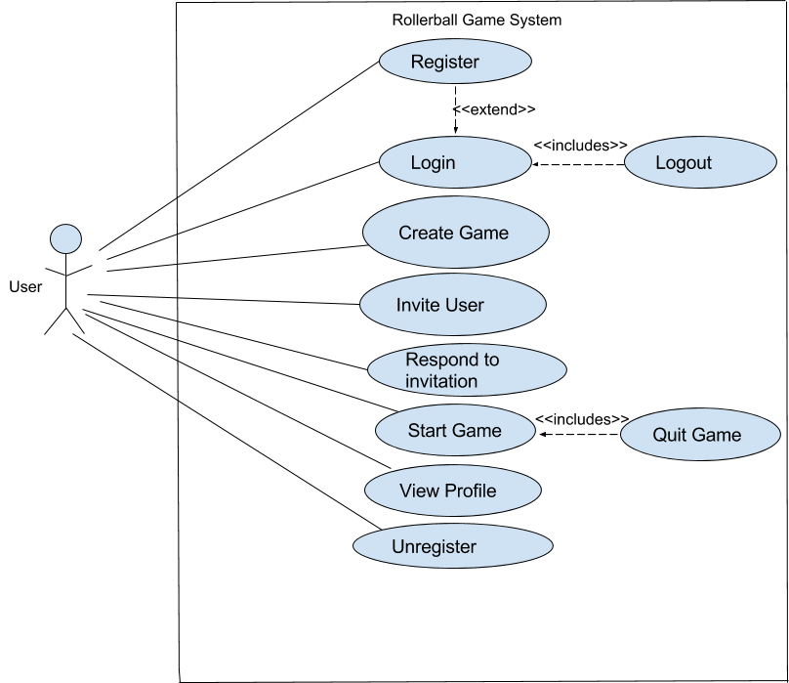
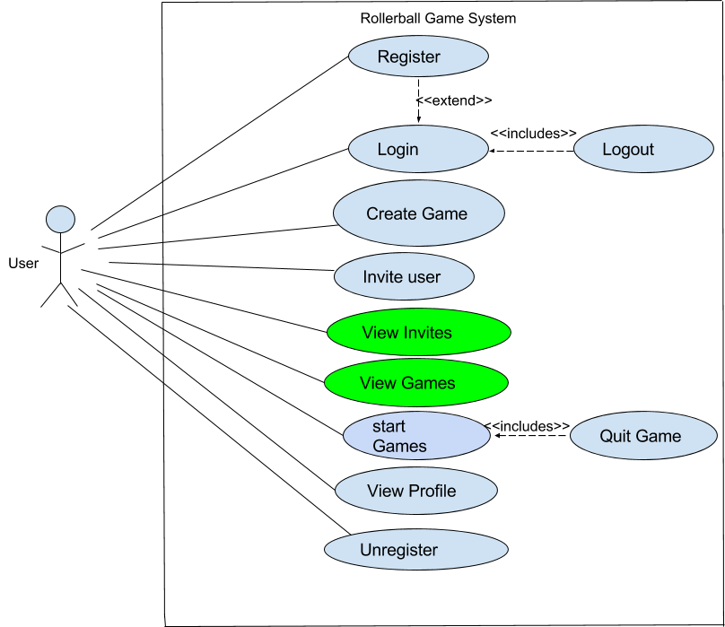
Use Case Diagram
Old
New

Slide 15
System Test Cases Completed
System Test | Pass/Fail
Login | Pass
Logout | Pass
Register | Pass
Unregister | Pass
View Invites | Pass
Start Game | Pass
Quit Game | Pass
View Profile | Pass
Create Game | Pass
Invite User | Pass

Slide 16
Test Case
Step | Action | Expected System Response | Pass/Fail | Comment
1 | Enter Username “test” | Nothing
2 | Enter password “password” | Nothing
3 | Click “Login” | Notification user is logged in | Pass
 | Alternative Flow: Incorrect credentials
4 | Enter Bad Username “tste” | Nothing
5 | Enter Bad Password “psswd” | Nothing
6 | Click “Login” | Notification of Bad Input | Pass | Asks to register this user
Pre-Conditions: User is Registered already with credentials username: “test” password: “password”
Test Case #: 1 System: Rollerball Designed by: Nik F Executed by: Nik F | Test Case Name: Try to Login Subsystem: Login Design Date: 12/1/17 Execution Date: 12/1/17
Short Description: See if login system works.
Post-Conditions: User is now logged into the system

Slide 17
Refactoring
To play across multiple machines
All database calls made by the server
Clients request/send data to the server
Server stores/grabs data from the server
Relays data back to client if necessary

Slide 18
Challenges & Lessons
A few challenges we’ve faced along the way and what we’ve learned:
Different schedules make it difficult to meet in person:
Because of different class schedules and work schedules it is difficult to get together all at once.
We learned that to make it work, we need to set up times that can accommodate both in person and remote meetings via phone or hangout.
Different coding styles make it difficult to integrate:
We all have different coding styles, so it could be difficult at times to make changes and additions to the code if we couldn’t quite understand what the other coder was trying to accomplish.
We learned that commenting code is extra important as well as consistent communication.

Slide 19
Code Demo

Slide 20
Questions?
Thank you

